Slide 1
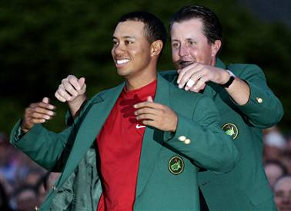
Golf Stats Matter
Alex Blickle

Slide 2
Research Questions
1. Which statistics matter most in predicting money earned on the PGA Tour?
  Make a model for predicting money earned
2. Has there been an increase in driving distance with the “technological boom”?

Slide 3
Which Statistics?
Driving Distance
Driving Accuracy
Greens in Regulation
Proximity to Hole
Scrambling
Strokes Gained Putting

Slide 4
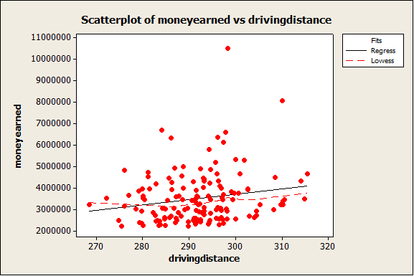
Tests for Association- Driving Distance
nonparametric: driving distance and money earned
z = 2.475, p-value = 0.006662
parametric: t = 2.3419, df = 148, p-value = 0.01026

Slide 5
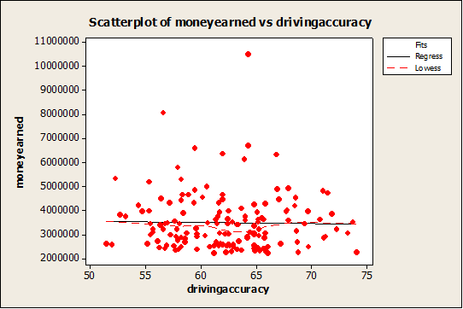
Tests for Association- Driving Accuracy
nonparametric: driving accuracy and money earned
z = -0.3413, p-value = 0.6335
parametric: t = -0.2954, df = 148, p-value = 0.6159

Slide 6
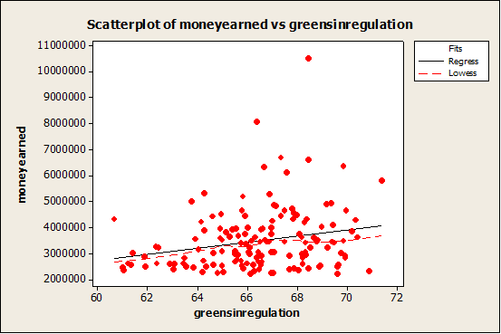
Tests for Association- Greens in Regulation
nonparametric: greens in regulation and money earned
z = 2.5984, p-value = 0.004683
parametric: t = 2.7756, df = 148, p-value = 0.003111

Slide 7
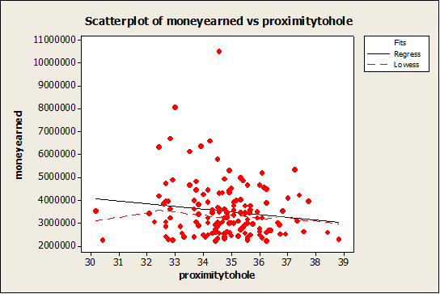
Tests for Association- Proximity to Hole
nonparametric: proximity to hole and money earned
z = -1.1624, p-value = 0.1225
parametric: t = -1.6798, df = 148, p-value = 0.04755

Slide 8
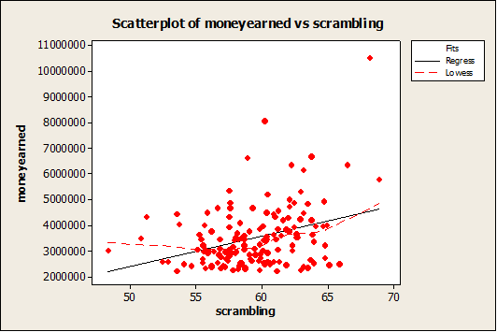
Tests for Association- Scrambling
nonparametric: scrambling and money earned
z = 3.3378, p-value = 0.0004223
parametric: t = 4.4424, df = 148, p-value = 8.659e-06

Slide 9
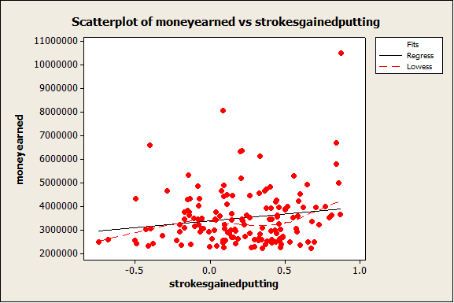
Tests for Association- Strokes Gained Putting
nonparametric: strokes gained putting and money earned
z = 1.1017, p-value = 0.1353
parametric: t = 2.0241, df = 148, p-value = 0.02238

Slide 10
Significant Evidence
I can conclude significant positive association with:
  Driving Distance & Money Earned
  Greens in Regulation % & Money Earned
  Scrambling & Money Earned
I can conclude significant positive linear correlation between:
  Driving Distance & Money Earned
  Greens in Regulation % & Money Earned
  Proximity to Hole & Money Earned (negative)
  Scrambling & Money Earned
  Strokes Gained Putting & Money Earned
  *What can I conclude in general?

Slide 11
Regression Equations
money earned = - 3944781 + 25497 driving distance (p-value=.011, r²=3.6)
money earned = - 4193526 + 115676 greens in regulation (p-value=.003, r²=4.9)
money earned = 7595906 - 117834 proximity to hole (p-value=.043, r²=1.9)
money earned = - 3598533 + 119446 scrambling (p-value=0.000, r²=11.9)
money earned = 3373982 + 581258 strokes gained putting (p-value=.023, r²=2.7)

Slide 12
Model for Money Earned
moneyearned = - 25647938 + 60288 driving distance + 102603 greens in regulation - 143948 proximity to hole + 162152 scrambling + 430758 strokes gained putting.
r²(adjusted) value = 30.8

Slide 13
Does it Work?
Tiger’s 2009: - 25647938 + 60288(298.4) + 102603(68.46) - 143948(34.58) + 162152(68.18) + 430758(0.874)= $5,820,487.
In reality, Tiger won $10,508,163, but that was one of the greatest years in history so the model actually worked quite well. In fact, the model would have placed him in 2nd on the year to Steve Stricker who had slightly over 6 million made.
Bubba’s 2012: - 25647938 + 60288(315.5) + 102603(69.95) - 143948(36) + 162152(56.58)+ 430758(-0.285)= $4,419,672.
Bubba actually won $4,644,997, so the model worked extremely well in predicting his money earned for 2012.

Slide 14
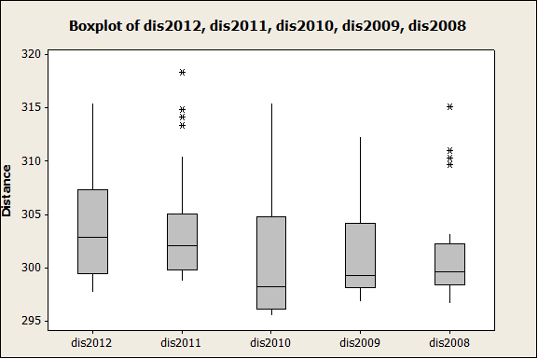
Driving Distance
Jonckheere Terpstra
J = 5374, p-value = 0.001858

Slide 15
Multiple Comparisons
I concluded significant difference, where the year listed first is larger, in:
  2012 & 2010
  2012 & 2009
  2011 & 2010
  2011 & 2009
  2011 & 2008

Slide 16
Driving Distance Block Design
Page’s Procedure
  P-value=.4212
Two Way Anova
  P-value=.036

Slide 17
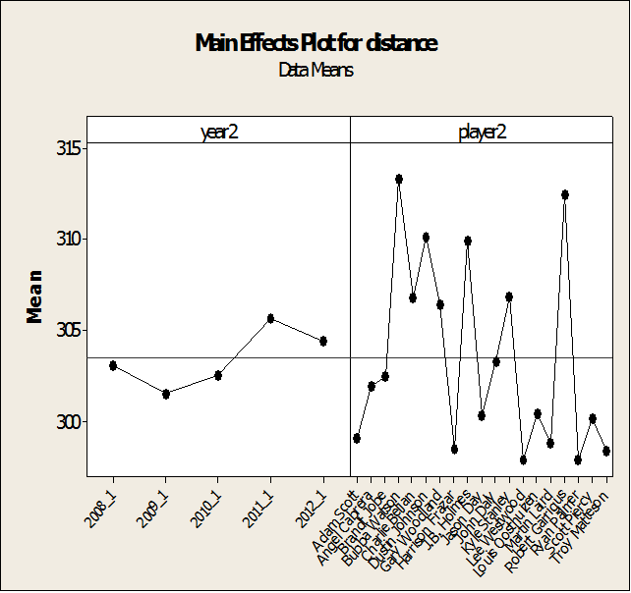
Player Variability

Slide 18
Conclusions
Driving Distance has increased significantly over the past 5 years
Scrambling is the most powerful statistic for predicting Money Earned

